Slide 1
Cheat Sheet
By: Steven Dale-jenkins

Slide 2
What is my project about?
Makes it easy for end user to have a way to get reference document for any desired tech field.
Making a easy to use GUI website that is user friendly and professional.

Slide 3
Tools used
Cascading Style Sheets
Bootstrap
Atom
GitHub
JavaScript

Slide 4
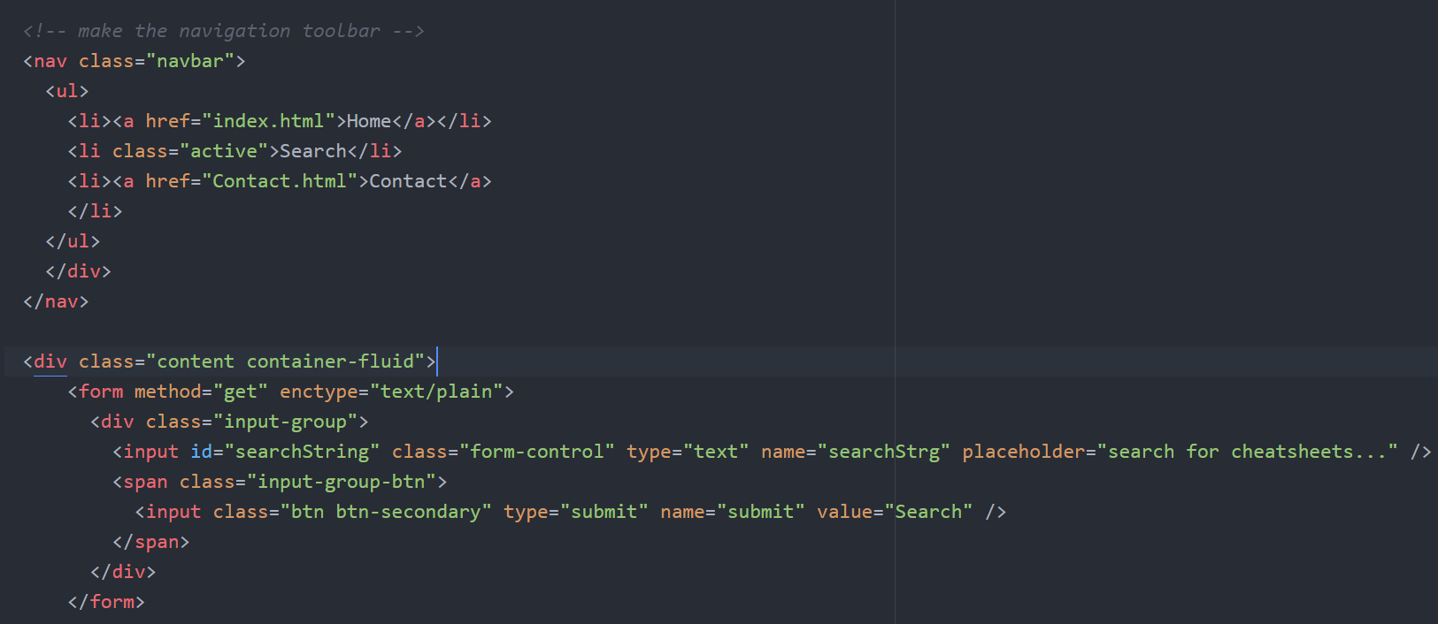
Html

Slide 5
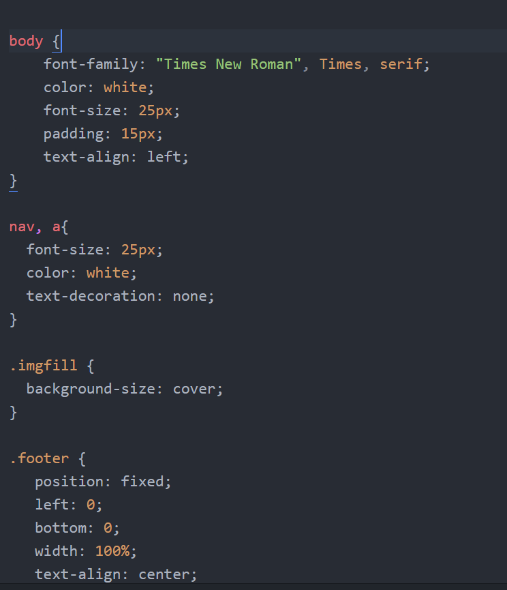
CSS

Slide 6
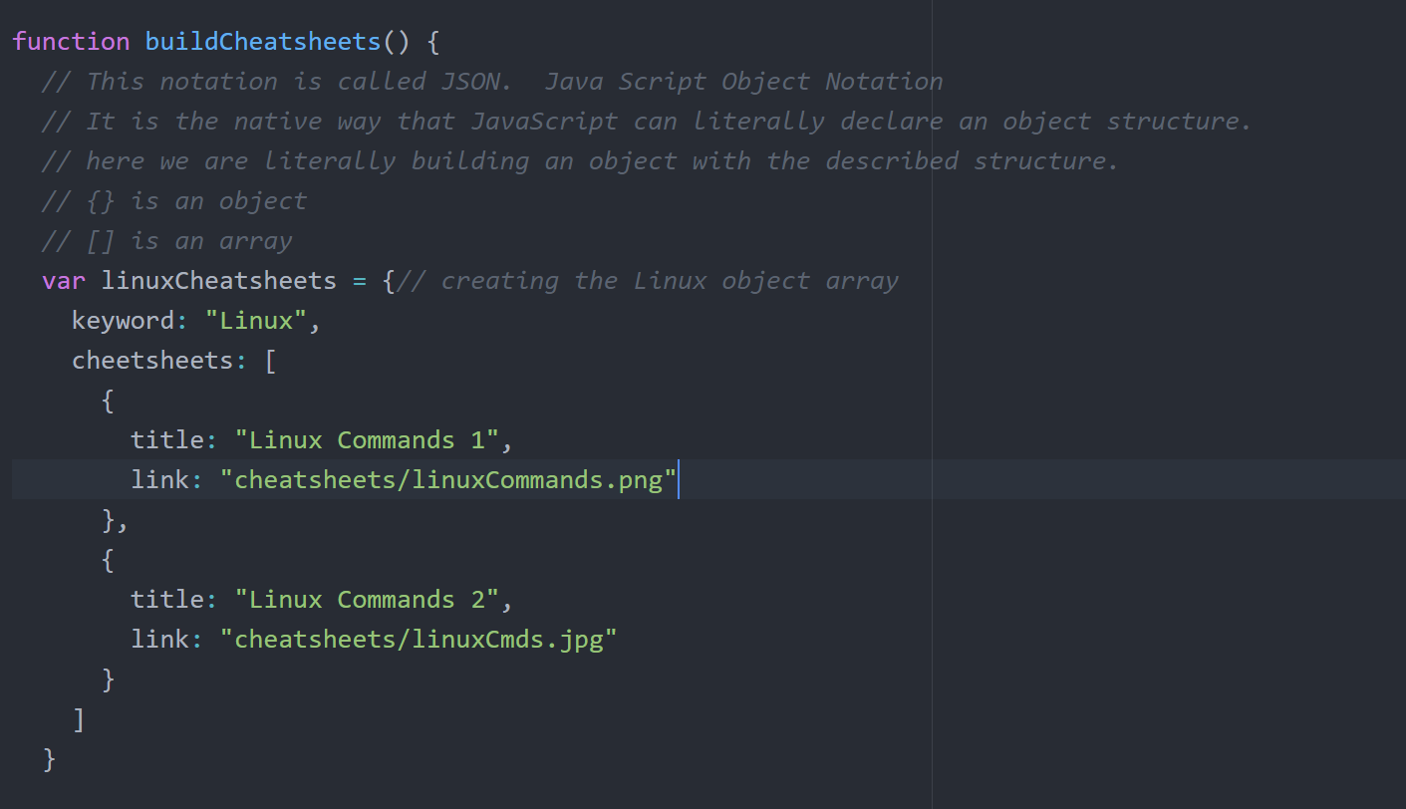
Javascript

Slide 7
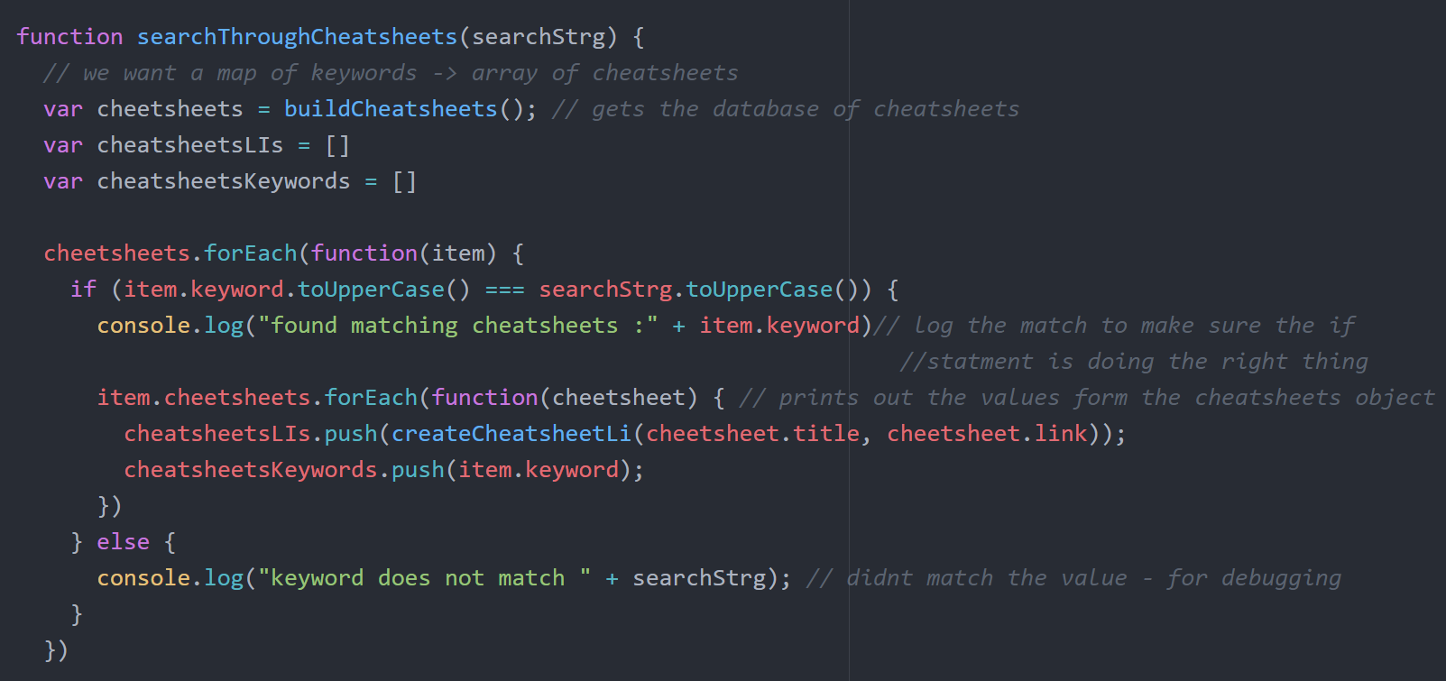
Javascript Continued

Slide 8
Sites Neat features
The search function in this site is the bread and butter.
It give errors if there was nothing entered.
Gives error if the phase was not found.
Does console logging for debugging purposes.
Gives option for “Did you mean ...?”
All images are styled to auto scale for easier screen viewing.

Slide 9
Hope you enjoyed it!
Overall great experience and I hope that I the future version of my project I will be able to expand my database and try to have more content.

Slide 10
Work cited
Linux Images
https://www.techworm.net/2016/10/download-cheat-sheet-learn-basic-linux-commands.html
https://www.cheatography.com/davechild/cheat-sheets/linux-command-line/
Windows Images
https://www.amazon.com/Windows-Quick-Reference-Instructions-Shortcuts/dp/1936220016
C# images
https://www.cheatography.com/cheatography/cheat-sheets/core-c-and-net-quick-reference/
C++ Images
http://cpprocks.com/regex-cheatsheet/

